Slide 1
ElGamal Cryptosystem
In 1984 Taher ElGamal presented a cryptosystem which is based on the Discrete Logarithm.
Thus ElGamal simplified the Die-Hellman key exchange algorithm by introducing
a random exponent k.
The ElGamal cryptosystem is usually used in a hybrid cryptosystem.
It is faster to encrypt the symmetric with Elgamal and the with a symmetric cipher.
There are THREE aspects in EIGamal Cryptography
EIGamal Key Generation
EIGamal Key Encryption
EIGamal Key Decryption

Slide 2
EIGamal Key Generation
Steps 1:- Select a large prime number P, This is first part of Public Key.
Step 2:- Select a decryption key or private key D.
Steps 3:- Select the Second part of public key as E1.
Steps 4:- The Third part of public key as E2= E1˄D mod P
Step 5:- The Public key will be (E1,E2,P) and Private key will be D.
Example:-
Consider P=11, E1=2 and D=3
Then E2= E1˄D mod P = 2˄3 mod 11 = 8
Hence public key will be ((2,8,11) and private key D=3

Slide 3
EIGamal Key Encryption
Steps 1:- Select a random integer R.
Step 2:- Compute the First part of cipher text C1= E1˄R mod P .
Steps 3:- Compute the Second part of cipher text C2=PT. E2˄R mod P .
Steps 4:- The Final cipher text is (C1,C2)
Example:-
Let R= 4 and PT = 7
From Previous P=11, E1=2 and D=3
and public key will be (2,8,11)
C1 = E1˄R mod P = 2˄4 mod11= 5
C2=PT. E2˄R mod P = 7. 2˄8 mod 11 = 6
Hence Cipher Text is (5,6)

Slide 4
EIGamal Key Decryption
Steps 1:- Compute the plain text using the following formula
PT = (C2.C1˄D) ˄ -1 mod P
Example:-
PT = (C2.C1˄D) ˄ -1 mod P
PT = (6. 5˄3) ˄-1 mod 11
\ PT = (6.3) mod 11= 7

Slide 5
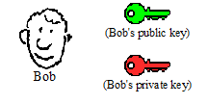
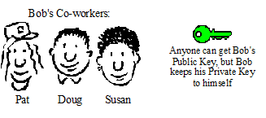
Digital Signature
A digital signature is a mathematical scheme for demonstrating the authenticity of a digital message or documents.
Bob has been given two keys. One of Bob's keys is called a Public Key, the other is called a Private Key.
Bob's Public key is available to anyone who needs it, but he keeps his Private Key to himself. Keys are used to encrypt information. Either one of Bob's two keys can encrypt data, and the other key can decrypt that data.

Slide 6
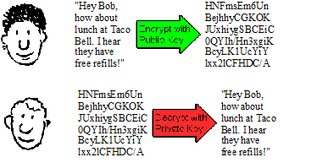
Susan can encrypt a message using Bob's Public Key. Bob uses his Private Key to decrypt the message. Any of Bob's coworkers might have access to the message Susan encrypted, but without Bob's Private Key, the data is worthless.
With his private key and the right software, Bob can put digital signatures on documents and other data.
A digital signature is a "stamp" Bob places on the data which is unique to Bob, and is very difficult to forge. In addition, the signature assures that any changes made to the data that has been signed can not go undetected.

Slide 7
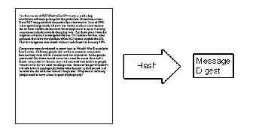
To sign a document, Bob's software will crunch down the data into just a few lines by a process called "hashing". These few lines are called a message digest. (It is not possible to change a message digest back into the original data from which it was created.)
Bob's software then encrypts the message digest with his private key. The result is the digital signature.

Slide 8
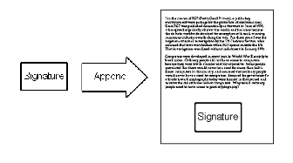
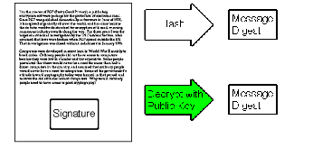
Finally, Bob's software appends the digital signature to document. All of the data that was hashed has been signed.

Slide 9
Message Digest
Message digests are secure one-way hash functions that take arbitrary-sized data and output a fixed-length hash value.
A Message Digest object starts out initialized. The data is processed through it using the update methods. At any point reset can be called to reset the digest.
Message digest is basically a fingerprint or summary of the message.
Message digest functions also called hash functions , are used to produce digital summaries of information called message digests.
Message digests are commonly 128 bits to 160 bits in length and provide a digital identifier for each digital file or document.
It is similar to CRC or LRC.

Slide 11
Introduction
MD5 algorithm was developed by Professor Ronald L. Rivest in 1991. According to RFC 1321, “MD5 message-digest algorithm takes as input a message of arbitrary length and produces as output a 128-bit "fingerprint" or "message digest" of the input …The MD5 algorithm is intended for digital signature applications, where a large file must be "compressed" in a secure manner before being encrypted with a private (secret) key under a public-key cryptosystem such as RSA.”

Slide 12
MD5 Algorithm Structure

Slide 13
Implementation Steps
Step1 Append padding bits
The input message is "padded" (extended) so that its length (in bits) equals to 448 mod 512. Padding is always performed, even if the length of the message is already 448 mod 512.
Padding is performed as follows: a single "1" bit is appended to the message, and then "0" bits are appended so that the length in bits of the padded message becomes congruent to 448 mod 512. At least one bit and at most 512 bits are appended.

Slide 14
Implementation Steps
Step2. Append length
A 64-bit representation of the length of the message is appended to the result of step1. If the length of the message is greater than 2^64, only the low-order 64 bits will be used.
The resulting message (after padding with bits and with b) has a length that is an exact multiple of 512 bits. The input message will have a length that is an exact multiple of 16 (32-bit) words.

Slide 15
Implementation Steps
Step3. Initialize MD buffer
A four-word buffer (A, B, C, D) is used to compute the message digest. Each of A, B, C, D is a 32-bit register. These registers are initialized to the following values in hexadecimal, low-order bytes first):
word A: 01 23 45 67
word B: 89 ab cd ef
word C: fe dc ba 98
word D: 76 54 32 10

Slide 16
Implementation Steps
Step4. Process message in 16-word blocks
Four functions will be defined such that each function takes an input of three 32-bit words and produces a 32-bit word output.
F (X, Y, Z) = XY or not (X) Z
G (X, Y, Z) = XZ or Y not (Z)
H (X, Y, Z) = X xor Y xor Z
I (X, Y, Z) = Y xor (X or not (Z))

Slide 17
Implementation Steps
Round 1.
[abcd k s i] denote the operation a = b + ((a + F (b, c, d) + X [k] + T [i]) <<< s).
Do the following 16 operations.
[ABCD 0 7 1] [DABC 1 12 2] [CDAB 2 17 3] [BCDA 3 22 4]
[ABCD 4 7 5] [DABC 5 12 6] [CDAB 6 17 7] [BCDA 7 22 8]
[ABCD 8 7 9] [DABC 9 12 10] [CDAB 10 17 11] [BCDA 11 22 12]
[ABCD 12 7 13] [DABC 13 12 14] [CDAB 14 17 15] [BCDA 15 22 16]

Slide 18
SECURE HASHING ALGORITHM Purpose: Authentication : Not Encryption
Authentication Requirements:
Masquerade – Insertion of message from fraudulent source
Content Modification – Changing content of message
Sequence Modification – Insertion, deletion and reordering sequence
Timing Modification – Replaying valid sessions
Notes:
Verify that received messages come from the alleged source and have not been altered. Also verify the sequence and timing. Digital Signature is used to combat denial of receipt of a message by either the source or desitination.

Slide 19
Applications: One-way hash functions
Public Key Algorithms
Password Logins
Encryption Key Management
Digital Signatures
Integrity Checking
Virus and Malware Scanning
Authentication
Secure Web Connections
(PGP, SSL, SSH, S/MIME)

Slide 20
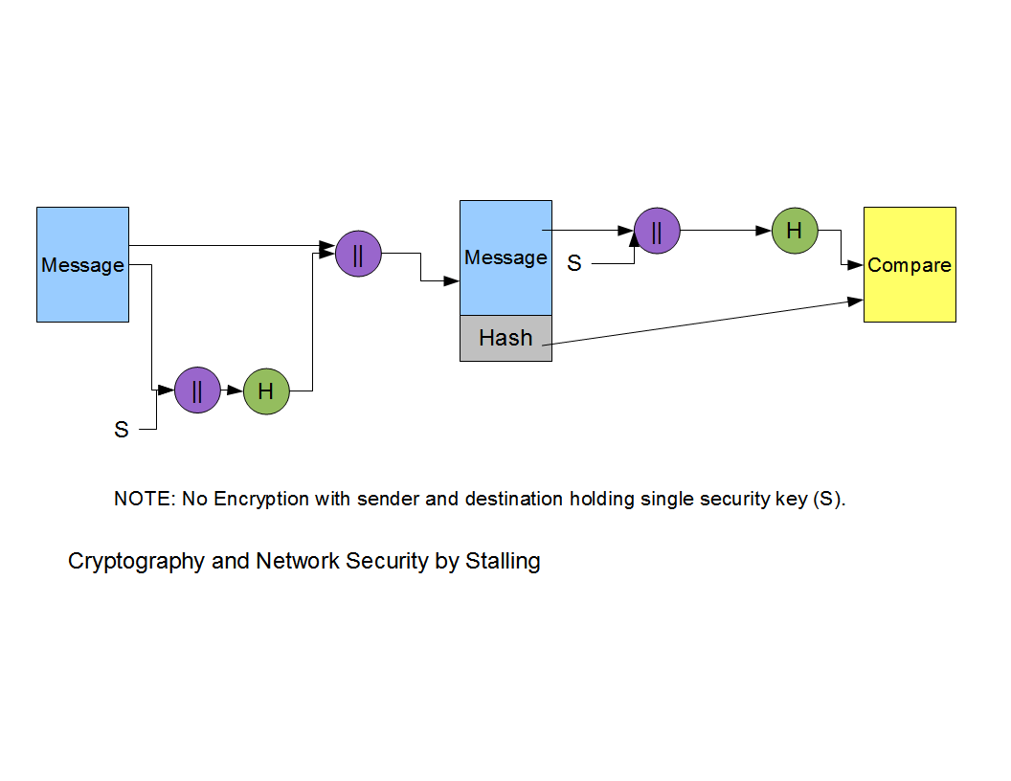
Basic Hash Function Diagram

Slide 21
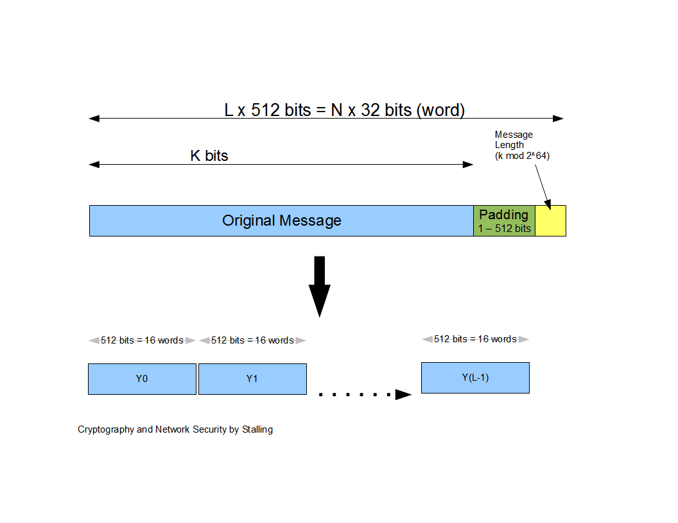
Message Diagram

Slide 22
SHA-1 (160 bit message) Algorithm Framework
Step 1: Append Padding Bits….
Message is “padded” with a 1 and as many 0’s as necessary to bring the message length to 64 bits fewer than an even multiple of 512.
Step 2: Append Length....
64 bits are appended to the end of the padded message. These bits hold the binary format of 64 bits indicating the length of the original message.
http://www.herongyang.com
f

Slide 23
SHA-1 Framework Continued
Step 3: Prepare Processing Functions….
SHA1 requires 80 processing functions defined as:
f(t;B,C,D) = (B AND C) OR ((NOT B) AND D) ( 0 <= t <= 19)
f(t;B,C,D) = B XOR C XOR D (20 <= t <= 39)
f(t;B,C,D) = (B AND C) OR (B AND D) OR (C AND D) (40 <= t <=59)
f(t;B,C,D) = B XOR C XOR D (60 <= t <= 79)
Step 4: Prepare Processing Constants....
SHA1 requires 80 processing constant words defined as:
K(t) = 0x5A827999 ( 0 <= t <= 19)
K(t) = 0x6ED9EBA1 (20 <= t <= 39)
K(t) = 0x8F1BBCDC (40 <= t <= 59)
K(t) = 0xCA62C1D6 (60 <= t <= 79)
http://www.herongyang.com

Slide 24
SHA-1 Framework Continued
Step 5: Initialize Buffers….
SHA1 requires 160 bits or 5 buffers of words (32 bits):
H0 = 0x67452301
H1 = 0xEFCDAB89
H2 = 0x98BADCFE
H3 = 0x10325476
H4 = 0xC3D2E1F0
http://www.herongyang.com

Slide 25
SHA-1 Framework Final Step
Step 6: Processing Message in 512-bit blocks (L blocks in total message)….
This is the main task of SHA1 algorithm which loops through the padded and appended message in 512-bit blocks.
Input and predefined functions:
M[1, 2, ..., L]: Blocks of the padded and appended message f(0;B,C,D), f(1,B,C,D), ..., f(79,B,C,D): 80 Processing Functions K(0), K(1), ..., K(79): 80 Processing Constant Words
H0, H1, H2, H3, H4, H5: 5 Word buffers with initial values
http://www.herongyang.com

Slide 26
SHA-1 Framework Continued
Step 6: Pseudo Code….
For loop on k = 1 to L
(W(0),W(1),...,W(15)) = M[k] /* Divide M[k] into 16 words */
For t = 16 to 79 do:
W(t) = (W(t-3) XOR W(t-8) XOR W(t-14) XOR W(t-16)) <<< 1
A = H0, B = H1, C = H2, D = H3, E = H4
For t = 0 to 79 do:
TEMP = A<<<5 + f(t;B,C,D) + E + W(t) + K(t) E = D, D = C,
C = B<<<30, B = A, A = TEMP
End of for loop
H0 = H0 + A, H1 = H1 + B, H2 = H2 + C, H3 = H3 + D, H4 = H4 + E
End of for loop
Output:
H0, H1, H2, H3, H4, H5: Word buffers with final message digest
http://www.herongyang.com

Slide 27
Message Diagram

Slide 28
SHA-1 Message Digest
The message digest of the string:
“This is a test for theory of computation”
4480afca4407400b035d9debeb88bfc402db514f

Slide 29
Cryptanalysis and Limitation
Key Premises for Hash Functions:
1. Impossible to re-create a message given a fingerprint
2. Collision Free
SHA-1 failure using brute force attack in 2⁸⁰ operations
Collision failure found in 2005 in 2³³ operations

Slide 30
Merkle-Hellman Knapsack
One of first public key systems
Based on NP-complete problem
Original algorithm is weak
Lattice reduction attack
Newer knapsacks are more secure
But nobody uses them…
Once bitten, twice shy

Slide 31
Knapsack Problem
Given a set of n weights W₀,W₁,...,W_{n-1} and a sum S, is it possible to find a_{i} ∈ {0,1} so that
S = a₀W₀+a₁W₁ +...+ a_{n-1}W_{n-1}
(technically, this is “subset sum” problem)
Example
Weights (62,93,26,52,166,48,91,141)
Problem: Find subset that sums to S = 302
Answer: 62+26+166+48 = 302
The (general) knapsack is NP-complete

Slide 32
Knapsack Problem
General knapsack (GK) is hard to solve
But superincreasing knapsack (SIK) is easy
In SIK each weight greater than the sum of all previous weights
Example
Weights (2,3,7,14,30,57,120,251)
Problem: Find subset that sums to S = 186
Work from largest to smallest weight
Answer: 120+57+7+2 = 186

Slide 33
Knapsack Cryptosystem
Generate superincreasing knapsack (SIK)
Convert SIK into “general” knapsack (GK)
Public Key: GK
Private Key: SIK plus conversion factors
Easy to encrypt with GK
With private key, easy to decrypt (convert ciphertext to SIK)
Without private key, must solve GK ?

Slide 34
Knapsack Cryptosystem
Let (2,3,7,14,30,57,120,251) be the SIK
Choose m = 41 and n = 491 with m and n relatively prime, n > sum of SIK elements
General knapsack
2 ⋅ 41 (mod 491) = 82
3 ⋅ 41 (mod 491) = 123
7 ⋅ 41 (mod 491) = 287
14 ⋅ 41 (mod 491) = 83
30 ⋅ 41 (mod 491) = 248
57 ⋅ 41 (mod 491) = 373
120 ⋅ 41 (mod 491) = 10
251 ⋅ 41 (mod 491) = 471
General knapsack: (82,123,287,83,248,373,10,471)

Slide 35
Knapsack Example
Private key: (2,3,7,14,30,57,120,251)
m⁻¹ mod n = 41⁻¹ (mod 491) = 12
Public key: (82,123,287,83,248,373,10,471), n=491
Example: Encrypt 10010110
82 + 83 + 373 + 10 = 548
To decrypt,
548 · 12 = 193 (mod 491)
Solve (easy) SIK with S = 193
Obtain plaintext 10010110

Slide 36
Knapsack Weakness
Trapdoor: Convert SIK into “general” knapsack using modular arithmetic
One-way: General knapsack easy to encrypt, hard to solve; SIK easy to solve
This knapsack cryptosystem is insecure
Broken in 1983 with Apple II computer
The attack uses lattice reduction
“General knapsack” is not general enough!
This special knapsack is easy to solve

Slide 37
Elliptic Curve Cryptography
Elliptic curve cryptography (ECC) is an approach to public-key cryptography based on the algebraic structure of elliptic curves over finite fields. One of the main benefits in comparison with non-ECC cryptography (with plain Galois fields as a basis) is the same level of security provided by keys of smaller size.
Components
Private Key | Public Key | Set of Operations | Domain Parameters (Predefined constants)
A random number | Point on a curve = Private Key * G | These are defined over the curve y² = x³ + ax + b, where 4a³ + 27b² ≠ 0 | G, a, b

Slide 38
Discrete Logarithm Problem (DLP)
Let P and Q be two points on the elliptic curve
Such that Q = kP, where k is a scalar value
DLP: Given P and Q, find k?
If k is very large, it becomes computationally infeasible
The security of ECC depends on the difficulty of DLP
Main operation in ECC is Point Multiplication

Slide 39
Point Multiplication
Point Multiplication is achieved by two basic curve operations:
1. Point Addition, L = J + K
2. Point Doubling, L = 2J
Example:
If k = 23; then, kP = 23*P
= 2(2(2(2P) + P) + P) + P

Slide 40
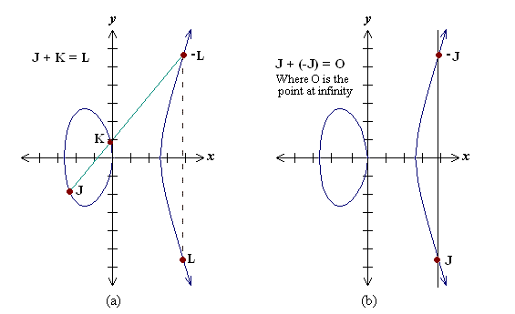
Point Addition
Geometrical explanation:

Slide 41
Point Addition
Analytical explanation:
Consider two distinct points J and K such that J = (x_{J}, y_{J}) and K = (x_{K}, y_{K})
Let L = J + K where L = (x_{L}, y_{L}), then
x_{L} = s² - x_{J} – x_{K}
y_{L} = -y_{J} + s (x_{J} – x_{L})
s = (y_{J} – y_{K})/(x_{J} – x_{K}), s is slope of the line through J and K

Slide 42
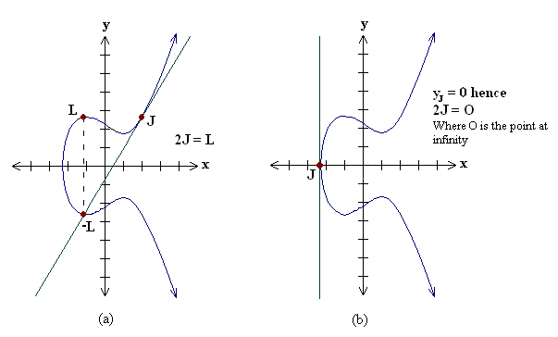
Point Doubling
Geometrical explanation:

Slide 43
Point Doubling
Analytical explanation
Consider a point J such that J = (x_{J}, y_{J}), where y_{J} ≠ 0
Let L = 2J where L = (x_{L}, y_{L}), Then
x_{L} = s² – 2x_{J}
y_{L} = -y_{J} + s(x_{J} - x_{L})
s = (3x_{J}² + a) / (2y_{J}), s is the tangent at point J and a is one of the parameters chosen with the elliptic curve

Slide 44
Finite Fields
The Elliptic curve operations shown were on real numbers
Issue: operations are slow and inaccurate due to round-off errors
To make operations more efficient and accurate, the curve is defined over two finite fields
1. Prime field F_{p} and
2. Binary field F₂^{m}
The field is chosen with finitely large number of points suited for cryptographic operations

Slide 45
EC on Prime field F_{p}
Elliptic Curve equation:
y² mod p= x³ + ax + b mod p
where 4a³ + 27b² mod p ≠ 0.
Elements of finite fields are integers between 0 and p-1
The prime number p is chosen such that there is finitely large number of points on the elliptic curve to make the cryptosystem secure.
SEC specifies curves with p ranging between 112-521 bits

Slide 46
EC on Binary field F₂^{m}
Elliptic Curve equation:
y² + xy = x³ + ax² + b,
where b ≠ 0
Here the elements of the finite field are integers of length at most m bits.
In binary polynomial the coefficients can only be 0 or 1.
The m is chosen such that there is finitely large number of points on the elliptic curve to make the cryptosystem secure.
SEC specifies curves with m ranging between 113-571 bits

Slide 47
Elliptic Curve Domain parameters
Domain parameters for EC over field F_{p}
Parameters:
p, a, b, G, n and h.
Domain parameters for EC over field F₂^{m}
Parameters:
m, f(x), a, b, G, n and h.

Slide 48
Implementations
ECDSA - Elliptic Curve Digital Signature Algorithm
Signature Generation:
For signing a message m by sender A, using A’s private key d_{A}
and public key Q_{A} = d_{A} * G
1. Calculate e = HASH (m), where HASH is a cryptographic hash function, such as
SHA-1
2. Select a random integer k from [1,n − 1]
3. Calculate r = x₁ (mod n), where (x₁, y₁) = k * G. If r = 0, go to step 2
4. Calculate s = k ⁻ ¹(e + d_{A}r)(mod n). If s = 0, go to step 2
5. The signature is the pair (r, s)

Slide 49
Implementations
ECDSA - Elliptic Curve Digital Signature Algorithm
Signature Verification:
For B to authenticate A's signature, B must have A’s public key Q_{A}
1. Verify that r and s are integers in [1,n − 1]. If not, the signature is invalid
2. Calculate e = HASH (m), where HASH is the same function used in the signature generation
3. Calculate w = s ⁻¹ (mod n)
4. Calculate u₁ = ew (mod n) and u₂ = rw (mod n)
5. Calculate (x₁, y₁) = u₁G + u₂Q_{A}
6. The signature is valid if x₁ = r(mod n), invalid otherwise

Slide 50
Implementations
ECDH – Elliptic Curve Diffie Hellman
A (Q_{A,}d_{A}) – Public, Private Key pair
B (Q_{B,}d_{B}) – Public, Private Key pair
1. The end A computes K = (x_{K}, y_{K}) = d_{A} * Q_{B}
2. The end B computes L = (x_{L}, y_{L}) = d_{B} * Q_{A}
3. Since d_{A}Q_{B} = d_{A}d_{B}G = d_{B}d_{A}G = d_{B}Q_{A}. Therefore K = L
and hence x_{K} = x_{L}
4. Hence the shared secret is x_{K}

